Slide 1
Note
This lecture is the last lecture in scope for Spring 2021 midterm 2.

Slide 2

CS61B, 2021
Lecture 22: Graphs II: Graph Traversal Implementations
BreadthFirstPaths
Graph API
Graph Representations and Graph Algorithm Runtimes
Graph Traversal Runtimes
Layers of Abstraction
Notes:
First hit for random on google images: http://imalbum.aufeminin.com/album/D20090918/595987_CDFNNMFIKOXZB2ECNEHVLRX4BSJB4I_chester-2020_H204533_L.jpg

Slide 3
Tree and Graph Traversals
Just as there are many tree traversals:
Preorder: DBACFEG
Inorder: ABCDEFG
Postorder: ACBEGFD
Level order: DBFACEG
D
B
F
A
C
E
G
So too are there many graph traversals, given some source:
DFS Preorder: 012543678 (dfs calls).
DFS Postorder: 347685210 (dfs returns).
BFS order: Act in order of distance from s.
BFS stands for “breadth first search”.
Analogous to “level order”. Search is wide, not deep.
0 1 24 53 68 7
3
0
1
4
6
s
2
5
7
8

Slide 4
Shortest Paths Challenge
2
s
0
3
5
1
4
6
7
Goal: Given the graph above, find the shortest path from s to all other vertices.
Give a general algorithm.
Hint: You’ll need to somehow visit vertices in BFS order.
Hint #2: You’ll need to use some kind of data structure.
Hint #3: Don’t use recursion.

Slide 5
BFS Answer
Breadth First Search.
Initialize a queue with a starting vertex s and mark that vertex.
A queue is a list that has two operations: enqueue (a.k.a. addLast) and dequeue (a.k.a. removeFirst).
Let’s call this the queue our fringe.
Repeat until queue is empty:
Remove vertex v from the front of the queue.
For each unmarked neighbor n of v:
Mark n.
Set edgeTo[n] = v (and/or distTo[n] = distTo[v] + 1).
Add n to end of queue.
Demo: Breadth First Paths
A queue is the opposite of a stack. Stack has push (addFirst) and pop (removeFirst).
Do this if you want to track distance value.

Slide 6
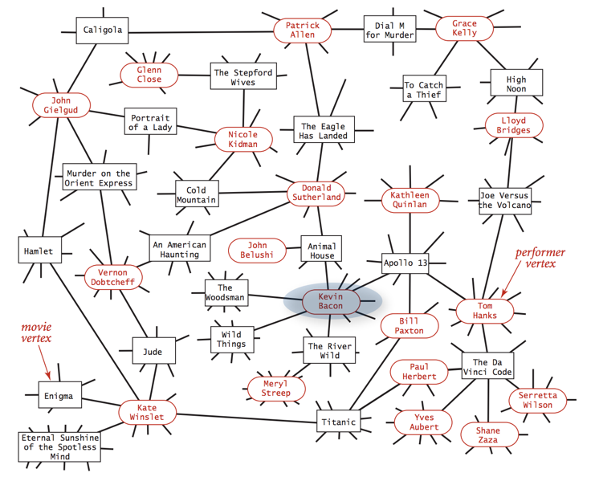
One use of BFS: Kevin Bacon
Graph with two types of vertices:
Movies
Actors
Perform BFS from s=Kevin Bacon.
Notes:
https://upload.wikimedia.org/wikipedia/commons/d/d2/Kevin_Bacon.jpg
https://oracleofbacon.org/movielinks.php
https://en.wikipedia.org/wiki/Six_Degrees_of_Kevin_Bacon
https://www.youtube.com/watch?v=tr_FFfAP6jI&t=2m34s

Slide 7
BreadthFirstSearch for Google Maps
Would breadth first search be a good algorithm for a navigation tool (e.g. Google Maps)?
Assume vertices are intersection and edges are roads connecting intersections.

Slide 8
BreadthFirstSearch for Google Maps
Would breadth first search be a good algorithm for a navigation tool (e.g. Google Maps)?
Assume vertices are intersection and edges are roads connecting intersections.
Some roads are longer than others.
BAD!
Will discuss how to deal with this in the next lecture.
First, we should talk about how graphs and graph algorithms are actually implemented in a programming language.

Slide 9
Graph API

Slide 10
Graph Representations
To Implement our graph algorithms like BreadthFirstPaths and DepthFirstPaths, we need:
An API (Application Programming Interface) for graphs.
For our purposes today, these are our Graph methods, including their signatures and behaviors.
Defines how Graph client programmers must think.
An underlying data structure to represent our graphs.
Our choices can have profound implications on:
Runtime.
Memory usage.
Difficulty of implementing various graph algorithms.

Slide 11
Graph API Decision #1: Integer Vertices
Common convention: Number nodes irrespective of “label”, and use number throughout the graph implementation. To lookup a vertex by label, you’d need to use a Map<Label, Integer>.
Dallas
1
Map<String, Integer>:
Austin: 0
Dallas: 1
Houston: 2
0
Austin
Houston
2
Intended graph.
How you’d build it.

Slide 12
Graph API
The Graph API from our optional textbook.
public class Graph {
public Graph(int V): Create empty graph with v vertices
public void addEdge(int v, int w): add an edge v-w
Iterable<Integer> adj(int v): vertices adjacent to v
int V(): number of vertices
int E(): number of edges
...
Some features:
Number of vertices must be specified in advance.
Does not support weights (labels) on nodes or edges.
Has no method for getting the number of edges for a vertex (i.e. its degree).

Slide 13
Graph API
The Graph API from our optional textbook.
Example client:
public class Graph {
public Graph(int V): Create empty graph with v vertices
public void addEdge(int v, int w): add an edge v-w
Iterable<Integer> adj(int v): vertices adjacent to v
int V(): number of vertices
int E(): number of edges
...
/** degree of vertex v in graph G */
public static int degree(Graph G, int v) {
int degree = 0;
for (int w : G.adj(v)) {
degree += 1;
}
return degree; }
0
(degree = # edges)
3
1
2
degree(G, 1) = 2

Slide 14
Graph API
The Graph API from our optional textbook.
Challenge: Try to write a client method called print that prints out a graph.
public class Graph {
public Graph(int V): Create empty graph with v vertices
public void addEdge(int v, int w): add an edge v-w
Iterable<Integer> adj(int v): vertices adjacent to v
int V(): number of vertices
int E(): number of edges
...
0
$ java printDemo
1 - 2
1 - 4
2 - 1
2 - 3
3 - 2
4 - 1
3
1
public static void print(Graph G) {
???
}
2

Slide 15
Graph API
The Graph API from our optional textbook.
Print client:
public class Graph {
public Graph(int V): Create empty graph with v vertices
public void addEdge(int v, int w): add an edge v-w
Iterable<Integer> adj(int v): vertices adjacent to v
int V(): number of vertices
int E(): number of edges
...
public static void print(Graph G) {
for (int v = 0; v < G.V(); v += 1){
for (int w : G.adj(v)) {
System.out.println(v + “-” + w);
}
}
}
$ java printDemo
0 - 1
0 - 3
1 - 0
1 - 2
2 - 1
3 - 0
0
3
1
2

Slide 16
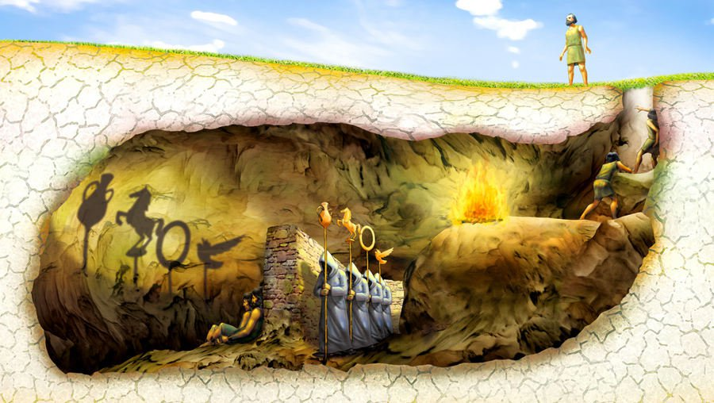
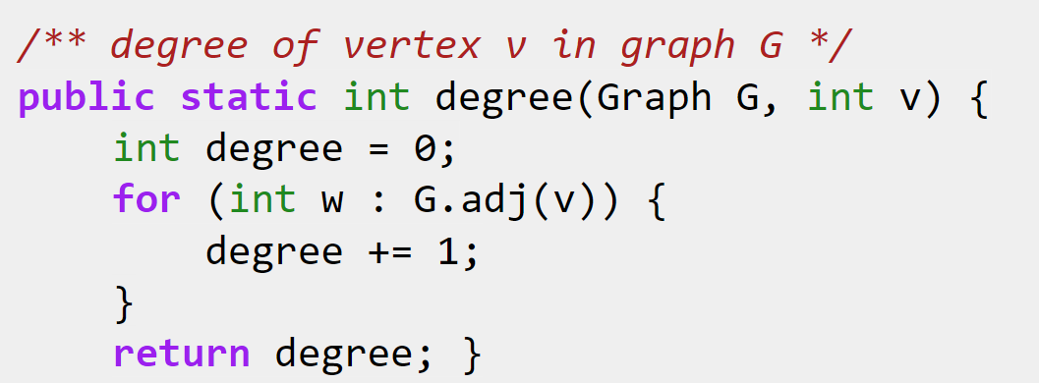
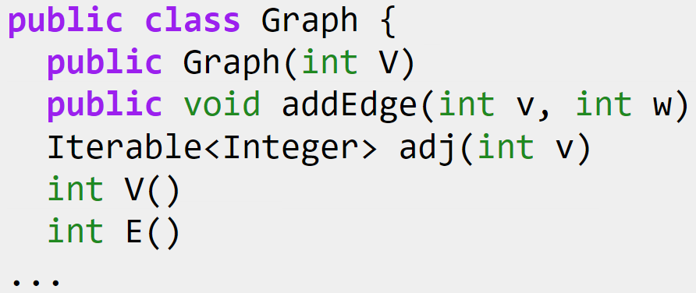
Graph API and DepthFirstPaths
Our choice of Graph API has deep implications on the implementation of DepthFirstPaths, BreadthFirstPaths, print, and other graph “clients”.
Will come back to this in more depth, but first...

Slide 17
Graph Representation and Graph Algorithm Runtimes

Slide 18
Graph Representations
To Implement our graph algorithms like BreadthFirstPaths and DepthFirstPaths, we need:
An API (Application Programming Interface) for graphs.
For our purposes today, these are our Graph methods, including their signatures and behaviors.
Defines how Graph client programmers must think.
An underlying data structure to represent our graphs.
Our choices can have profound implications on:
Runtime.
Memory usage.
Difficulty of implementing various graph algorithms.

Slide 19
Graph Representations
Just as we saw with trees, there are many possible implementations we could choose for our graphs.
Let’s review briefly some representations we saw for trees.

Slide 20
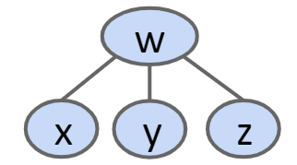
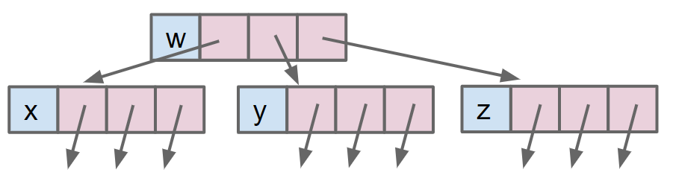
Tree Representations
We’ve seen many ways to represent the same tree. Example: 1a.
w
w
x
y
z
x
y
z
1a: Fixed Number of Links (One Per Child)

Slide 21
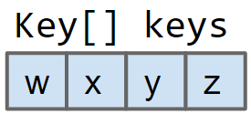
Tree Representations
We’ve seen many ways to represent the same tree. Example: 3.
Key[] keys
w
w
x
y
z
x
y
z
3: Array of Keys
Uses much less memory and operations will tend to be faster.
… but only works for complete trees.

Slide 22
Graph Representations
Graph Representation 1: Adjacency Matrix.
t
1
 | 0 | 1 | 2
0 | 0 | 1 | 1
1 | 0 | 0 | 1
2 | 0 | 0 | 0
s
0
2
w
 | 0 | 1 | 2 | 3
0 | 0 | 1 | 0 | 0
1 | 1 | 0 | 1 | 0
2 | 0 | 1 | 0 | 1
3 | 0 | 0 | 1 | 0
v
For undirected graph: Each edge is represented twice in the matrix. Simplicity at the expense of space.
1
0
2
3

Slide 23
Graph Representations
Graph Representation 1: Adjacency Matrix.
G.adj(2) would return an iterator where we can call next() up to two times
next() returns 1
next() returns 3
Total runtime to iterate over all neighbors of v is Θ(V).
Underlying code has to iterate through entire array to handle next() and hasNext() calls.
w
 | 0 | 1 | 2 | 3
0 | 0 | 1 | 0 | 0
1 | 1 | 0 | 1 | 0
2 | 0 | 1 | 0 | 1
3 | 0 | 0 | 1 | 0
v
1
G.adj(2) returns an iterator that will ultimately provide 1, then 3.
0
2
3

Slide 24
Graph Printing Runtime: http://yellkey.com/allow
What is the order of growth of the running time of the print client from before if the graph uses an adjacency-matrix representation, where V is the number of vertices, and E is the total number of edges?
Θ(V)
Θ(V + E)
Θ(V²)
Θ(V*E)
Runtime to iterate over v’s neighbors?
How many vertices do we consider?
for (int v = 0; v < G.V(); v += 1) {
for (int w : G.adj(v)) {
System.out.println(v + “-” + w);
}
}
 | 0 | 1 | 2 | 3
0 | 0 | 1 | 0 | 0
1 | 1 | 0 | 1 | 0
2 | 0 | 1 | 0 | 1
3 | 0 | 0 | 1 | 0
1
0
2
3

Slide 25
Graph Printing Runtime: http://yellkey.com/allow
What is the order of growth of the running time of the print client from before if the graph uses an adjacency-matrix representation, where V is the number of vertices, and E is the total number of edges?
Θ(V)
Θ(V + E)
Θ(V²)
Θ(V*E)
Runtime to iterate over v’s neighbors?
Θ(V).
How many vertices do we consider?
V times.
for (int v = 0; v < G.V(); v += 1) {
for (int w : G.adj(v)) {
System.out.println(v + “-” + w);
}
}
 | 0 | 1 | 2 | 3
0 | 0 | 1 | 0 | 0
1 | 1 | 0 | 1 | 0
2 | 0 | 1 | 0 | 1
3 | 0 | 0 | 1 | 0
1
0
2
3

Slide 26
More Graph Representations
Representation 2: Edge Sets: Collection of all edges.
Example: HashSet<Edge>, where each Edge is a pair of ints.
1
{(0, 1), (0, 2), (1, 2)}
0
2

Slide 27
More Graph Representations
Representation 3: Adjacency lists.
Common approach: Maintain array of lists indexed by vertex number.
Most popular approach for representing graphs.
1
0
2
0
1
2
[1, 2]
[2]

Slide 28
Graph Printing Runtime: http://yellkey.com/just
What is the order of growth of the running time of the print client if the graph uses an adjacency-list representation, where V is the number of vertices, and E is the total number of edges?
Θ(V)
Θ(V + E)
Θ(V²)
Θ(V*E)
Runtime to iterate over v’s neighbors?
How many vertices do we consider?
for (int v = 0; v < G.V(); v += 1) {
for (int w : G.adj(v)) {
System.out.println(v + “-” + w);
}
}
b
0
1
2
[1, 2]
[2]
a
c

Slide 29
Graph Printing Runtime: http://yellkey.com/just
What is the order of growth of the running time of the print client if the graph uses an adjacency-list representation, where V is the number of vertices, and E is the total number of edges?
Θ(V)
Θ(V + E)
Θ(V²)
Θ(V*E)
Runtime to iterate over v’s neighbors? List can be between 1 and V items.
Ω(1), O(V).
How many vertices do we consider?
V.
Best case: Θ(V) Worst case: Θ(V²)
for (int v = 0; v < G.V(); v += 1) {
for (int w : G.adj(v)) {
System.out.println(v + “-” + w);
}
}
b
0
1
2
[1, 2]
[2]
a
c

Slide 30
Graph Printing Runtime: http://yellkey.com/effort
What is the order of growth of the running time of the print client if the graph uses an adjacency-list representation, where V is the number of vertices, and E is the total number of edges?
Θ(V)
Θ(V + E)
Θ(V²)
Θ(V*E)
Runtime to iterate over v’s neighbors? List can be between 0 and V items.
Ω(1), O(V).
How many vertices do we consider?
V.
Best case: Θ(V) Worst case: Θ(V²)
for (int v = 0; v < G.V(); v += 1) {
for (int w : G.adj(v)) {
System.out.println(v + “-” + w);
}
}
?
?
?
?
b
?
0
1
2
[1, 2]
[2]
a
c

Slide 31
Graph Printing Runtime: http://yellkey.com/effort
What is the order of growth of the running time of the print client if the graph uses an adjacency-list representation, where V is the number of vertices, and E is the total number of edges?
Θ(V)
Θ(V + E)
Θ(V²)
Θ(V*E)
Best case: Θ(V) Worst case: Θ(V²)
All cases: Θ(V + E)
Create V iterators.
Print E times.
Best case: Θ(V) Worst case: Θ(V²)
for (int v = 0; v < G.V(); v += 1) {
for (int w : G.adj(v)) {
System.out.println(v + “-” + w);
}
}
b
0
1
2
[1, 2]
[2]
a
c

Slide 32
Graph Printing Runtime
Runtime: Θ(V + E)
How to interpret: No matter what “shape” of increasingly complex graphs we generate, as V and E grow, the runtime will always grow exactly as Θ(V + E).
Example shape 1: Very sparse graph where E grows very slowly, e.g. every vertex is connected to its square: 2 - 4, 3 - 9, 4 - 16, 5 - 25, etc.
E is Θ(sqrt(V)). Runtime is Θ(V + sqrt(V)), which is just Θ(V).
Example shape 2: Very dense graph where E grows very quickly, e.g. every vertex connected to every other.
E is Θ(V²). Runtime is Θ(V + V²), which is just Θ(V²).
for (int v = 0; v < G.V(); v += 1) {
for (int w : G.adj(v)) {
System.out.println(v + “-” + w);
}
}
V is total number of vertices.
E is total number of edges in the entire graph.

Slide 33
Graph Representations
Runtime of some basic operations for each representation:
idea | addEdge(s, t) | for(w : adj(v)) | print() | hasEdge(s, t) | space used
adjacency matrix | Θ(1) | Θ(V) | Θ(V²) | Θ(1) | Θ(V²)
list of edges | Θ(1) | Θ(E) | Θ(E) | Θ(E) | Θ(E)
adjacency list | Θ(1) | Θ(1) to Θ(V) | Θ(V+E) | Θ(degree(v)) | Θ(E+V)
Note: These operations are not part of the Graph class’s API.
In practice, adjacency lists are most common.
Many graph algorithms rely heavily on adj(s).
Most graphs are sparse (not many edges in each bucket).

Slide 34
Bare-Bones Undirected Graph Implementation
public class Graph {
private final int V; private List<Integer>[] adj;
public Graph(int V) {
this.V = V;
adj = (List<Integer>[]) new ArrayList[V];
for (int v = 0; v < V; v++) {
adj[v] = new ArrayList<Integer>();
}
}
public void addEdge(int v, int w) {
adj[v].add(w); adj[w].add(v);
}
public Iterable<Integer> adj(int v) {
return adj[v];
}
}
Cannot create array of anything involving generics, so have to use weird cast as with project 1A.

Slide 35
Graph Traversal Implementations and Runtime

Slide 36

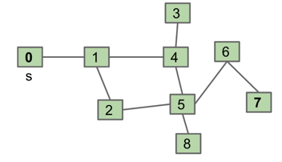
Depth First Search Implementation
Common design pattern in graph algorithms: Decouple type from processing algorithm.
Create a graph object.
Pass the graph to a graph-processing method (or constructor) in a client class.
Query the client class for information.
public class Paths {
public Paths(Graph G, int s): Find all paths from G
boolean hasPathTo(int v): is there a path from s to v?
Iterable<Integer> pathTo(int v): path from s to v (if any)
}
Paths.java

Slide 37
Example Usage
Start by calling: Paths P = new Paths(G, 0);
P.hasPathTo(3); //returns true
P.pathTo(3); //returns {0, 1, 4, 3}
Paths.java
public class Paths {
public Paths(Graph G, int s): Find all paths from G
boolean hasPathTo(int v): is there a path from s to v?
Iterable<Integer> pathTo(int v): path from s to v (if any)
}

Slide 38
DepthFirstPaths
Let’s review DepthFirstPaths by running the demo again.
Will then discuss:
Implementation.
Runtime.

Slide 39
DepthFirstPaths, Recursive Implementation
public class DepthFirstPaths {
private boolean[] marked;
private int[] edgeTo;
private int s;
public DepthFirstPaths(Graph G, int s) {
...
dfs(G, s);
}
private void dfs(Graph G, int v) {
marked[v] = true;
for (int w : G.adj(v)) {
if (!marked[w]) {
edgeTo[w] = v;
dfs(G, w);
}
}
}
...
}
marked[v] is true iff v connected to s
edgeTo[v] is previous vertex on path from s to v
not shown: data structure initialization
find vertices connected to s.
recursive routine does the work and stores results in an easy to query manner!
Question to ponder: How would we write pathTo(v) and hasPathTo(v)?
Answer on next slide.

Slide 40
DepthFirstPaths, Recursive Implementation
public class DepthFirstPaths {
private boolean[] marked;
private int[] edgeTo;
private int s;
...
public Iterable<Integer> pathTo(int v) {
if (!hasPathTo(v)) return null;
List<Integer> path = new ArrayList<>();
for (int x = v; x != s; x = edgeTo[x]) {
path.add(x);
}
path.add(s);
Collections.reverse(path);
return path;
}
public boolean hasPathTo(int v) {
return marked[v];
}
}
marked[v] is true iff v connected to s
edgeTo[v] is previous vertex on path from s to v

Slide 41
Runtime for DepthFirstPaths
Give a O bound for the runtime for the DepthFirstPaths constructor.
public class DepthFirstPaths {
private boolean[] marked;
private int[] edgeTo;
private int s;
public DepthFirstPaths(Graph G, int s) {
...
dfs(G, s);
}
private void dfs(Graph G, int v) {
marked[v] = true;
for (int w : G.adj(v)) {
if (!marked[w]) {
edgeTo[w] = v;
dfs(G, w);
}
}
} ...
}
Assume graph uses adjacency list!

Slide 42
Runtime for DepthFirstPaths
Give a O bound for the runtime for the DepthFirstPaths constructor.
public class DepthFirstPaths {
private boolean[] marked;
private int[] edgeTo;
private int s;
public DepthFirstPaths(Graph G, int s) {
...
dfs(G, s);
}
private void dfs(Graph G, int v) {
marked[v] = true;
for (int w : G.adj(v)) {
if (!marked[w]) {
edgeTo[w] = v;
dfs(G, w);
}
}
} ...
}
O(V + E)
Each vertex is visited at most once (O(V)).
Each edge is considered at most twice (O(E)).
vertex visits (no more than V calls)
edge considerations, each constant time
(no more than 2E calls)
Cost model in analysis above is the sum of:
Number of dfs calls.
marked[w] checks.
Assume graph uses adjacency list!

Slide 43
Various Cost Models for DFS
Four cost models for DFS:
Number of DFS calls: O(V)
Is an underestimate for families of graphs with tons of edges, e.g. we have genGraph(N) with N vertices and an edge between all pairs of vertices. Runtime would be worse than V.
Number of DFS + marked checks: O(V + E), but can simplify to O(E)
Also underestimates for families of graphs with very few edges.
Number of marked checks: O(E)
Is an underestimate for families of graphs with very few edges. So imagine, we have genGraph(N) which generates a graph with N nodes and sqrt(N) edges. As N grows, runtime would be worse than E.
Initialization of marked to false + marked checks: O(V + E)
This one does not underestimate.
We never formally defined asymptotics on multiple variables, and it turns out to be somewhat poorly defined.

Slide 44
Runtime for DepthFirstPaths
Very hard question: Could we say the runtime is O(E)?
public class DepthFirstPaths {
private boolean[] marked;
private int[] edgeTo;
private int s;
public DepthFirstPaths(Graph G, int s) {
...
dfs(G, s);
}
private void dfs(Graph G, int v) {
marked[v] = true;
for (int w : G.adj(v)) {
if (!marked[w]) {
edgeTo[w] = v;
dfs(G, w);
}
}
} ...
}
Argument: Can only visit a vertex if there is an edge to it.
# of DFS calls is bounded above by E.
So why not just say O(E)?
Assume graph uses adjacency list!

Slide 45
Runtime for DepthFirstPaths
Very hard question: Could we say the runtime is O(E)? No.
public class DepthFirstPaths {
private boolean[] marked;
private int[] edgeTo;
private int s;
public DepthFirstPaths(Graph G, int s) {
...
dfs(G, s);
}
private void dfs(Graph G, int v) {
marked[v] = true;
for (int w : G.adj(v)) {
if (!marked[w]) {
edgeTo[w] = v;
dfs(G, w);
}
}
} ...
}
Can’t say O(E)!
Constructor has to create an all false marked array.
This marking of all vertices as false takes Θ(V) time.
Our cost model earlier (dfs calls + marked checks) does not provide a tight bound.
Assume graph uses adjacency list!

Slide 46
Graph Problems
Problem | Problem Description | Solution | Efficiency (adj. list)
s-t paths | Find a path from s to every reachable vertex. | DepthFirstPaths.java Demo [update] | O(V+E) time Θ(V) space
Runtime is O(V+E)
Based on cost model: O(V) dfs calls and O(E) marked[w] checks.
Can’t say O(E) because creating marked array
Note, can’t say Θ(V+E), example: Graph with no edges touching source.
Space is Θ(V).
Need arrays of length V to store information.

Slide 47
BreadthFirstPaths Implementation
public class BreadthFirstPaths {
private boolean[] marked;
private int[] edgeTo;
...
private void bfs(Graph G, int s) {
Queue<Integer> fringe =
new Queue<Integer>();
fringe.enqueue(s);
marked[s] = true;
while (!fringe.isEmpty()) {
int v = fringe.dequeue();
for (int w : G.adj(v)) {
if (!marked[w]) {
fringe.enqueue(w);
marked[w] = true;
edgeTo[w] = v;
}
}
}
}
marked[v] is true iff v connected to s
edgeTo[v] is previous vertex on path from s to v
set up starting vertex
for freshly dequeued vertex v, for each neighbor that is unmarked:
Enqueue that neighbor to the fringe.
Mark it.
Set its edgeTo to v.

Slide 48
Graph Problems
Problem | Problem Description | Solution | Efficiency (adj. list)
s-t paths | Find a path from s to every reachable vertex. | DepthFirstPaths.java Demo | O(V+E) time Θ(V) space
s-t shortest paths | Find a shortest path from s to every reachable vertex. | BreadthFirstPaths.java Demo | O(V+E) time Θ(V) space
Runtime for shortest paths is also O(V+E)
Based on same cost model: O(V) .next() calls and O(E) marked[w] checks.
Space is Θ(V).
Need arrays of length V to store information.

Slide 49
Layers of Abstraction

Slide 50
Clients and Our Graph API
Our choice of Graph API has deep implications on the implementation of DepthFirstPaths, BreadthFirstPaths, print, and other graph “clients”.

Slide 51
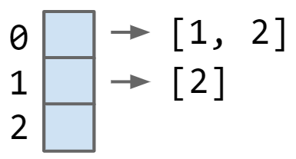
Our Graph API and Implementation
Our choice of how to implement the Graph API has profound implications on runtime.
Example: Saw that DepthFirstPaths on Adjacency Lists was O(V + E).

Slide 52
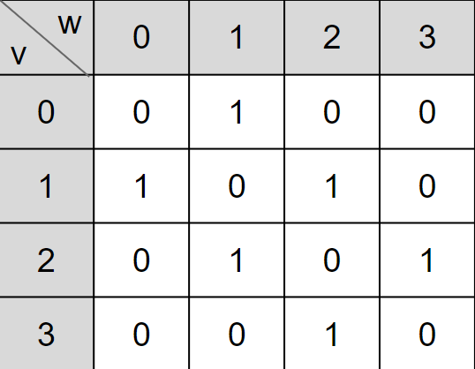
Our Graph API and Implementation
Our choice of how to implement the Graph API has profound implications on runtime.
What happens if to DepthFirstPaths runtime if we use an adjacency matrix?

Slide 53
Runtime for DepthFirstPaths
Give a tight O bound for the runtime for the DepthFirstPaths constructor.
public class DepthFirstPaths {
private boolean[] marked;
private int[] edgeTo;
private int s;
public DepthFirstPaths(Graph G, int s) {
...
dfs(G, s);
}
private void dfs(Graph G, int v) {
marked[v] = true;
for (int w : G.adj(v)) {
if (!marked[w]) {
edgeTo[w] = v;
dfs(G, w);
}
}
} ...
}
Assume graph uses adjacency matrix!

Slide 54
Runtime for DepthFirstPaths
Give a tight O bound for the runtime for the DepthFirstPaths constructor.
public class DepthFirstPaths {
private boolean[] marked;
private int[] edgeTo;
private int s;
public DepthFirstPaths(Graph G, int s) {
...
dfs(G, s);
}
private void dfs(Graph G, int v) {
marked[v] = true;
for (int w : G.adj(v)) {
if (!marked[w]) {
edgeTo[w] = v;
dfs(G, w);
}
}
} ...
}
O(V²)
In the worst case, we iterate over the neighbors of all vertices.
We create ≤ V iterators.
Each one takes a total of Θ(V) time to iterate over.
Essentially, iterating over the entire adjacency matrix takes O(V²) time.
Assume graph uses adjacency matrix!

Slide 55
Graph Problems for Adjacency Matrix Based Graphs
Problem | Problem Description | Solution | Efficiency (adj. matrix)
s-t paths | Find a path from s to every reachable vertex. | DepthFirstPaths.java Demo | O(V²) time Θ(V) space
s-t shortest paths | Find a shortest path from s to every reachable vertex. | BreadthFirstPaths.java Demo | O(V²) time Θ(V) space
If we use an adjacency matrix, BFS and DFS become O(V²).
For sparse graphs (number of edges << V for most vertices), this is terrible runtime.
Thus, we’ll always use adjacency-list unless otherwise stated.

Slide 56
Summary

Slide 57
Summary
BFS: Uses a queue instead of recursion to track what work needs to be done.
Graph API: We used the Princeton algorithms book API today.
This is just one possible API. We’ll see other APIs in this class.
Choice of API determines how client needs to think in order to write code.
e.g. Getting the degree of a vertex requires many lines of code with this choice of API.
Choice may also affect runtime and memory of client programs.
public class Graph {
public Graph(int V): Create empty graph with v vertices
public void addEdge(int v, int w): add an edge v-w
Iterable<Integer> adj(int v): vertices adjacent to v
int V(): number of vertices
int E(): number of edges ...

Slide 58
Summary
Graph Implementations: Saw three ways to implement our graph API.
Adjacency matrix.
List of edges.
Adjacency list (most common in practice).
Choice of implementation has big impact on runtime and memory usage!
DFS and BFS runtime with adjacency list: O(V + E)
DFS and BFS runtime with adjacency matrix: O(V²)

Slide 59
Citations
http://www.gosidemount.com/Guided_Diving/images/guided_cavern.jpg

Slide 60
Live Lecture Exercise

Slide 61
Switching Things Up
Breadth First Search.
Initialize a queue with a starting vertex s and mark that vertex.
A queue is a list that has two operations: enqueue (a.k.a. addLast) and dequeue (a.k.a. removeFirst).
Let’s call this the queue our fringe.
Repeat until queue is empty:
Remove vertex v from the front of the queue.
For each unmarked neighbor n of v:
Mark n.
Set edgeTo[n] = v (and/or distTo[n] = distTo[v] + 1).
Add n to end of queue.
Demo: Breadth First Paths
Do this if you want to track distance value.

Slide 62
Switching Things Up
??? First Search.
Initialize a queuestack with a starting vertex s and mark that vertex.
A stack is a list that has two operations: push (a.k.a. addLast) and pop (a.k.a. removeLast).
Let’s call this the queuestack our fringe.
Repeat until queue is empty:
Pop vertex v from the top of the stack.
For each unmarked neighbor n of v:
Mark n.
Set edgeTo[n] = v (and/or distTo[n] = distTo[v] + 1).
Push n to the top of of the queuestack.

Slide 63
Try running ??? first search. Assume adjacency lists are in numerical order.
Dives down a rabbit hole. Then makes its way back.
Depth first!!
3
??? First Search Visit Order: []
Stack:
0
1
4
6
s
0
7
2
5
8

Slide 64
Try running ??? first search. Assume adjacency lists are in numerical order.
Dives down a rabbit hole. Then makes its way back.
Depth first!!
3
??? First Search Visit Order: []
Stack:
0
1
4
6
s
0
7
2
5
8

Slide 65
Try running ??? first search. Assume adjacency lists are in numerical order.
Dives down a rabbit hole. Then makes its way back.
Depth first!!
3
??? First Search Visit Order: [0]
Stack:
0
1
4
6
s
2
5
7
8

Slide 66
Try running ??? first search. Assume adjacency lists are in numerical order.
Dives down a rabbit hole. Then makes its way back.
Depth first!!
3
??? First Search Visit Order: [0]
Stack:
0
1
4
6
s
1
7
2
5
8

Slide 67
Try running ??? first search. Assume adjacency lists are in numerical order.
Dives down a rabbit hole. Then makes its way back.
Depth first!!
3
??? First Search Visit Order: [0, 1]
Stack:
0
1
4
6
s
2
5
7
8

Slide 68
Try running ??? first search. Assume adjacency lists are in numerical order.
Dives down a rabbit hole. Then makes its way back.
Depth first!!
3
??? First Search Visit Order: [0, 1]
Stack:
0
1
4
6
4
s
2
7
2
5
8

Slide 69
Try running ??? first search. Assume adjacency lists are in numerical order.
Dives down a rabbit hole. Then makes its way back.
Depth first!!
3
??? First Search Visit Order:
[0, 1, 4]
5
6
Stack:
0
1
4
3
s
2
7
2
5
8

Slide 70
Try running ??? first search. Assume adjacency lists are in numerical order.
Dives down a rabbit hole. Then makes its way back.
Depth first!!
3
??? First Search Visit Order:
[0, 1, 4, 5]
Stack:
0
1
4
6
3
s
2
7
2
5
8

Slide 71
Try running ??? first search. Assume adjacency lists are in numerical order.
Dives down a rabbit hole. Then makes its way back.
Depth first!!
3
8
??? First Search Visit Order:
[0, 1, 4, 5]
6
6
Stack:
0
1
4
3
s
2
7
2
5
8

Slide 72
Try running ??? first search. Assume adjacency lists are in numerical order.
Dives down a rabbit hole. Then makes its way back.
Depth first!!
3
??? First Search Visit Order:
[0, 1, 4, 5, 8]
6
6
Stack:
0
1
4
3
s
2
7
2
5
*
8

Slide 73
Try running ??? first search. Assume adjacency lists are in numerical order.
Dives down a rabbit hole. Then makes its way back.
Depth first!!
3
??? First Search Visit Order:
[0, 1, 4, 5, 8, 6]
7
6
Stack:
0
1
4
3
s
2
7
2
5
8

Slide 74
Try running ??? first search. Assume adjacency lists are in numerical order.
Dives down a rabbit hole. Then makes its way back.
Depth first!!
3
??? First Search Visit Order:
[0, 1, 4, 5, 8, 6, 7]
Stack:
0
1
4
6
3
s
2
7
2
5
8

Slide 75
Try running ??? first search. Assume adjacency lists are in numerical order.
Dives down a rabbit hole. Then makes its way back.
Depth first!!
3
??? First Search Visit Order:
[0, 1, 4, 5, 8, 6, 7, 3]
Stack:
0
1
4
6
s
2
7
2
5
8

Slide 76
Try running ??? first search. Assume adjacency lists are in numerical order.
Dives down a rabbit hole. Then makes its way back.
Depth first!!
3
??? First Search Visit Order:
[0, 1, 4, 5, 8, 6, 7, 3, 2]
Stack:
0
1
4
6
s
2
5
7
8

Slide 77
Try running ??? first search. Assume adjacency lists are in numerical order.
Dives down a rabbit hole. Then makes its way back.
Depth first!!
3
??? First Search Visit Order:
[0, 1, 4, 5, 8, 6, 7, 3, 2]
Stack:
0
1
4
6
s
2
5
7
DFS (Pre-order):
[0, 1, 2, 5, 4, 3, 6, 7, 8]
8

Slide 78
Try running R???R first search, which uses reverse order of adjacency lists.
In other words, 5’s adjacency list is: 2->4->6->8, so let’s do it backwards
EVEN THIS IS NOT classic DFS
??? First Search Visit Order:
[0, 1, 4, 5, 8, 6, 7, 3, 2]
3
R???R First Search Visit Order:
[0, 1, 2, 5, 6 RRRHRHH (buzzer sound)]
6
Stack:
0
1
4
s
2
5
7
DFS (Pre-order):
[0, 1, 2, 5, 4, 3, 6, 7, 8]
8

Slide 79
Interesting fact:
ANY recursive algorithm can be implemented using iteration and a stack.
So DFS (which we implemented recursively) can be implemented using a stack data structure.
So far we’ve uncovered ??? first search and R???R first search.
These two algorithms are close cousins of DFS-breaking-ties-alphabetically search, but are NOT quite the same.
R???R is a closer cousin.
Tweaking the algorithm so that our iterative algorithm yields the exact same output as our recursive one will require more work.
In 61C, you’ll learn how recursive calls are implemented at a low level using a stack, i.e. in REAL recursive code, there is an explicit stack being utilized (but below the level of abstraction that you usually think about).

